Slide 1
JAVA SE BASICS
Introduction to JAVA SE

Slide 2
Table of contents
1. Getting Started with Java
Introduction to Eclipse IDE
Objects and Classes
Using Java Objects
Inheritance, Abstract Classes and Interfaces
Inner Classes
Exceptions
Collections and Generic Types
Java I/O
Java Annotation

Slide 3
1. Getting Started with Java
What is Java?
JVM
JDK and JRE
Source Code
Packages
Variables
Data Types
Keywords and Reserved Words
Identifiers
Oracle’s Java Naming Convention
Methods
Access Modifiers
Operators
Expressions
Statements
Flow Control
Comments

Slide 4
What is Java?
platform independent
applications run on JVM (Java Virtual Machine)
highly portable - “write once, run anywhere”
Java is object-oriented
supports objects, classes and inheritance
interpreted language
Java source code is transferred into bytecode format
bytecode does not depend on target platform
bytecode instructions interpreted by the JVM
Java is a strongly typed language
checked at compile and run time
automatic memory management
Java manages memory allocation, de-allocation (garbage collection)

Slide 5
Java and C++
Java
pointer arithmetic not supported
Java uses compiler which converts source code into intermediate language (bytecode)
platform independent
Java uses both compiler and interpreter
Java does not support multiple inheritance
Java does not support template classes
Java does not provide global variables
C++
pointer arithmetic is a main feature of the language
c++ uses compiler which converts source code into machine level instructions
heavily dependant of the underlying operating system
c++ uses only compiler
c++ supports multiple inheritance
c++ offer Template classes
global variables can be declared in c++

Slide 6
Java and PHP
Java
Java is a strongly typed language
general purpose language
Java is object oriented by default
Java object method calls use the . operator
constructors in Java are named after the class name
Java supports method overloading
PHP
PHP is weakly or dynamically typed language
server-side scripting language
PHP offers OOP as an option
PHP object method calls use the -> operator
constructors in PHP are called __construct()
PHP does not support method overloading

Slide 7
Java and C#
Java
Java was influenced by C/C++ programming language
Java does not support operator overloading
Java allows parameters to be passed by value
Java provides checked exceptions
C#
C# is based on C/C++ programming language
C# supports operator overloading
C# allows parameters to be passed by reference
C# does not provide checked exceptions

Slide 8
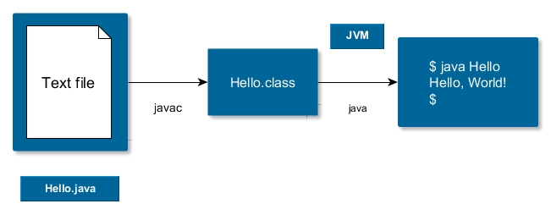
JVM
Java Virtual Machine
a JVM is an implementation of the Java Virtual Machine Specification, interprets compiled Java binary code (bytecode)
programs are compiled by the Java compiler into bytecode
Java Virtual Machine interprets compiled Java bytecode and executes the Java program
example JVM implementations: HotSpot, RoboVM, SAPJVM, JRockit, etc.

Slide 9
JDK and JRE
Java distribution: two basic types
Java Runtime Environment (JRE)
Java Development Kit (JDK)
The Java Development Kit is an implementation of either one of the Java Standard Edition (SE), Java Enterprise Edition (EE) or Java Micro Edition (ME) platforms released by Oracle Corporation
JRE consists of
JVM
Java class libraries
JDK consists of
JRE
standard development tools (compiler, debugger, disassembler, etc.)

Slide 10
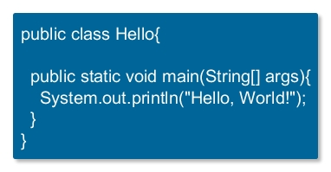
Source Code
unit of compilation is the source file (containing class and interface definitions)
java compiler (javac) creates bytecodes
bytecodes are stored in a .class files
.class files will be interpreted by the JVM
placed in a text file (with .java extension)
typically one class or interface per source file
source files are located in ordinary folders

Slide 11
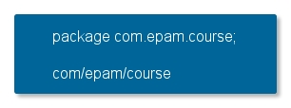
Packages
grouping classes and related subpackages
related functionality in different source files
namespace management
unique namespaces - avoid name collisions
create a hierarchical system
package name structure should match corresponding directory structure

Slide 12
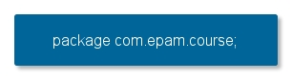
Packages cont’d
package keyword allows you to declare what package the classes shall belong to
package can be a single name or a specialized dot-separated name
by convention, use reversed Internet domain name for its package names
package declaration might be the first non-comment line
if a Java source file does not declare package statement it belongs to an unnamed (root) package
access restriction
default access is also known as package access: any other class within the same package will have full access
protected access: member can only be accessed within its own package and in addition, by a subclass of its class in another package

Slide 13

Using package Members
types that comprise a package are known as the package members
to use a public package member from outside its package
refer to the member by its fully qualified name
import the package member
import the member's entire package
refer to the member by its fully qualified name

Slide 14
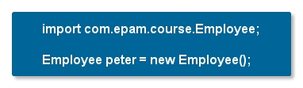
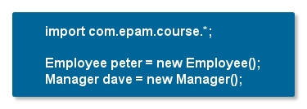
Using package Members cont’d
import the package member
import keyword
imports class names (not code) from a package
import the package member
import keyword
imports class names (not code) from a package

Slide 15
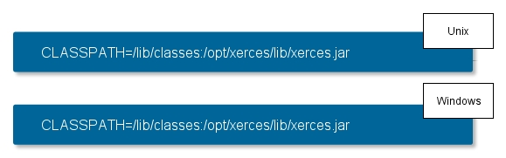
Classpath and Import
most Java apps are built from many classes
Java needs to locate class files
compiler needs class files at compile time
JVM needs class files at run time
initial check made in current directory
CLASSPATH environment variable
list of directories (or JAR files) containing class files
searched to a find required class

Slide 16
NoClassDefFound
JVM is not able to find a class at runtime which was available during compile time
NoClassDefFoundError
may be caused by CLASSPATH variable not being set correctly
NoClassDefFoundError is not the same as ClassNotFoundException
both of them related to Java Classpath
ClassNotFoundException
JVM tries to load a class at runtime dynamically
you give the name of the class at runtime and JVM does not find it
NoClassDefFoundError
problematic class was present during compile time
not available during runtime

Slide 17

Jar Files
Java archive files for classes and supporting files
same as the popular ZIP file format
jar files have additional information
a manifest file defining the archive contents (manifest.mf)
an optional digital signature for security
jar files can be included directly in the CLASSPATH

Slide 18

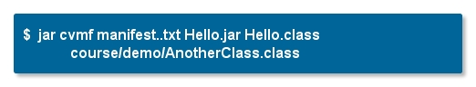

Manifest Attributes for Jar Files
manifest file contains attributes that act as metadata for the jar file
some generated by jar utility
others added manually
to build jar file with custom manifest file:
To run an application from a jar file

Slide 19
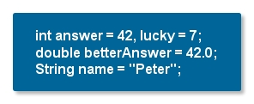
Variables
variables are entities in Java that can hold a value
Java programming language defines the following kinds of variables
instance variables
class variables (static fields)
local variables
parameters
all variables must be declared before first use
local variables go out of scope at the end of the enclosing block
multiple variables can be specified in one declaration

Slide 20
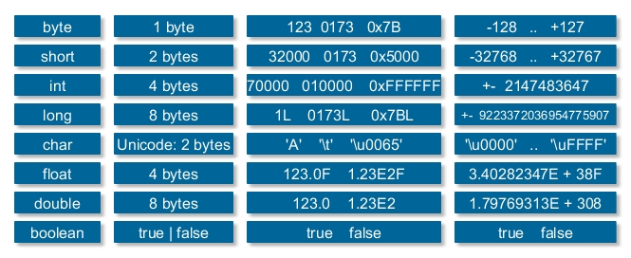
Primitive Data Types
a primitive is a simple non-object data type that represents a single value
primitive data types
boolean type
integral types (byte, short, int, long)
floating-point types (float, double)
textual type (char)

Slide 21

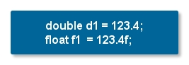
Literals
primitive types are special data types built into the language
not objects created from a class (no new keyword required)
to initialize a primitive data type, use literals
a literal is the source code representation of a fixed value
literals are represented directly in your code without requiring computation
integer literals
type long if it ends with the letter L or l
int otherwise
floating-point literal
type float if it ends with the letter F or f
double otherwise (optionally end with the letter D or d)

Slide 22
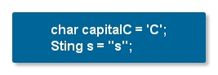
Literals cont’d
character and String literals
types char and String may contain any Unicode characters
null literal
value for any reference type
may be assigned to any variable, except variables of primitive types
is often used to represent uninitialized state
class literal
refers to the object (of type Class) that represents the type itself.

Slide 23
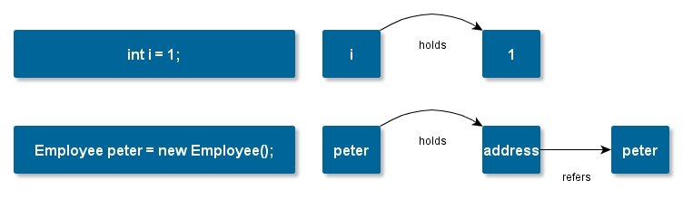
Reference Data Types
reference values (often just references) are pointers to objects
an object is a class instance or an array
a special null reference, which refers to no object
while primitive variables store primitive values
reference variables store addresses

Slide 24
Arrays
an array is a special object.
an array variable does not actually store the array
it is a reference variable that points to an array object
declaring the array variable does not create an array object instance
it merely creates the reference variable
the array object must be instantiated separately.
once instantiated, the array object contains a block of memory locations for the individual elements
if the individual elements are not explicitly initialized, they will be set to zero.
arrays can be created with a size that is determined dynamically (but once created, the size is fixed).

Slide 25
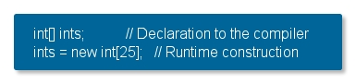
Arrays cont’d
ordered collection of primitives and references
to create and use array you must follow three steps:
declaration
construction
initialization
declaration does not specify size
size specified at runtime

Slide 26
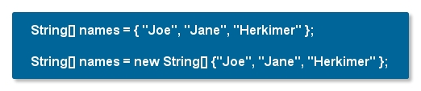
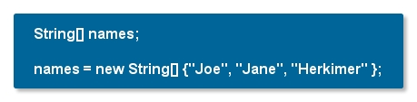
Arrays cont’d
initializing arrays
an array can be initialized when it is created
if a new array is being assigned to an existing variable
you cannot use the shorter variant
you must use the new keyword and the data type

Slide 27
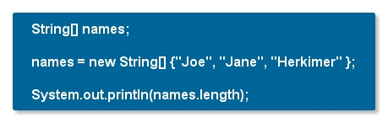
Working with arrays
as objects, arrays also have a useful property
length
it is a read-only property

Slide 28
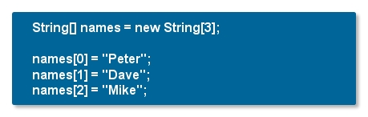
Working with Arrays cont’d
array elements are accessed through the array reference, by their array index
the index is the element number, placed within brackets
elements are numbered from 0 to one less than the specified size

Slide 29
Working with Arrays cont’d
array elements are accessed through the array reference, by their array index
the index is the element number, placed within brackets
elements are numbered from 0 to one less than the specified size

Slide 30
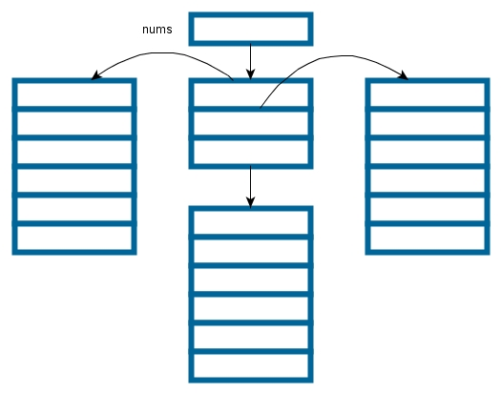

Multi-Dimensional Arrays
in Java a two-dimensional array is actually a single array
of array reference variables
each of which points to a single dimensional array
rows are allowed to vary in length

Slide 31
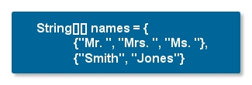
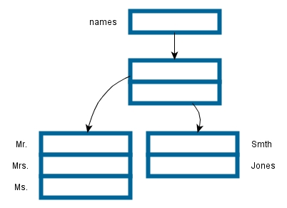
Multi-Dimensional Arrays cont’d

Slide 32
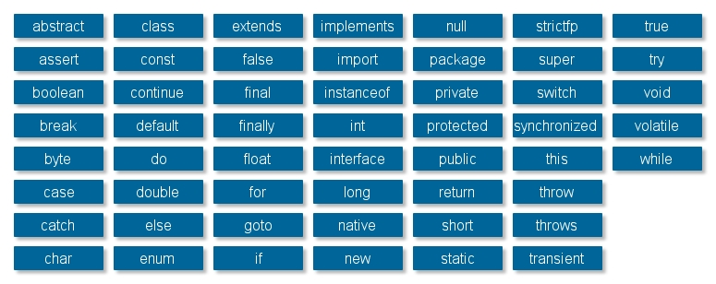
Keywords and Reserved Words
keywords are predefined identifiers reserved by Java for a specific purpose
true and false are not keywords
goto and const are reserved words

Slide 33
Identifiers
identifiers are the names of
variables
methods
classes
packages
Interfaces
Identifiers must be composed of
letters
numbers
the underscore sign (_)
the dollar sign ($)
identifiers may only begin with
a letter
the underscore
a dollar sign
identifiers are case sensitive

Slide 34
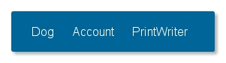
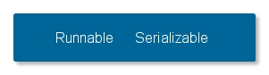
Oracle’s Java Naming Convention
identifiers: used to name variable, method, class, label
identifiers are case sensitive
classes and interfaces
first letter should be capitalized
camelCase, if several words are linked together to form the name
for classes, the names should typically be nouns
for interfaces, the names should typically be adjectives

Slide 35
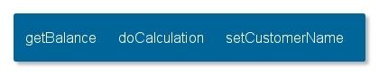
Oracle’s Java Naming Convention
Methods
first letter should be lowercase
normal camelCase rules afterwards
names should typically be verb-noun pairs

Slide 36
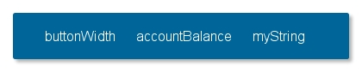
Oracle’s Java Naming Convention
Variables
camelCase, starting with a lowercase letter

Slide 37

Oracle’s Java Naming Convention
Constants
marked as static and final
uppercase letters
underscore character as separator

Slide 38
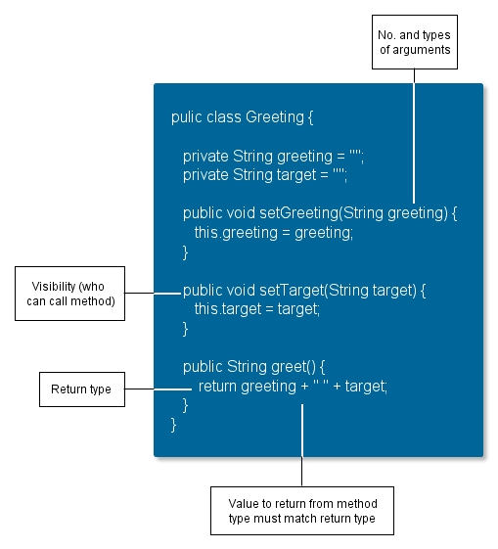

Methods
method: a callable, reusable unit of code
to define a method, need to provide:
name
return type
list of arguments with type
a method can return a value of any type or nothing
signature: contains the name of the method and the list of parameter types
overloading

Slide 39
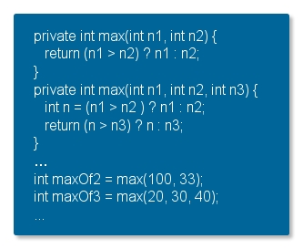
Overloading
Method names could be overloaded
normally within same class
formal parameter lists must be different
return type may be different
method signature is combination of name and parameter types (not names)
name mangling
return type is not part of the mechanism
parameter names are not part either

Slide 40
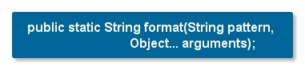
Varargs
prior Java 1.5
method that took an arbitrary number of values required you to create an array and put the values into the array
since Java 1.5
varargs feature automates and hides the process
three periods after the final parameter's type indicate that the final argument may be passed as an array or as a sequence of arguments
important uses in core APIs include
reflection,
message formatting
the new printf facility

Slide 41
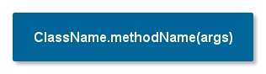
Static Methods
static methods: method with static modifier in their declarations
should be invoked with the class name
without the need for creating an instance of the class
static methods can access static variables and static methods directly
static methods cannot access instance variables or instance methods directly
they must use an object reference.
static methods cannot use the this keyword as there is no instance for this to refer to.

Slide 42

The main Method
main method: the Virtual Machine begins execution by invoking this method
public: VM has access to it
static: no need for object creation
void: doesn’t return a value
main: not Main, start, or anything else
String args[]: one parameter exactly, an array of Strings
can be: String[] args
Exception in thread "main" java.lang.NoSuchMethodError: main

Slide 43
Command Line Arguments
command line arguments
the only parameter of main method
array of Strings
VM copies runtime arguments from the program’s command line
accepts any number of arguments from the command line

Slide 44
Access Modifiers
class features
the class itself
its member variables
its methods and constructors
its nested classes or interfaces
the access modifiers are
public
private
protected
feature with no access modifier: default (aka. package private)

Slide 45
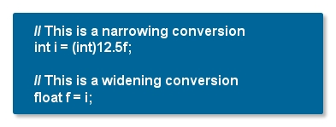
Java Operators
casting
Java allows you to make explicit casts from one primitive type to another
with the exception of the boolean primitive type
widening-conversion
narrowing conversion (explicit)
to perform a cast, you simply put the desired type between parenthesis: ()

Slide 46
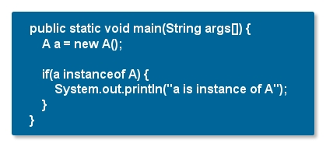
Java Operators cont’d
instanceof operator
type comparison operator
compares an object to a specified type
when using the instanceof operator, keep in mind that null is not an instance of anything

Slide 47
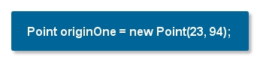
Java Operators cont’d
new operator
a class provides the blueprint for objects; you create an object from a class
new operator instantiates a class by allocating memory for a new object and returning a reference to that memory
new operator is followed by a call to a constructor, which initializes the new object
new operator requires a single, postfix argumen

Slide 48
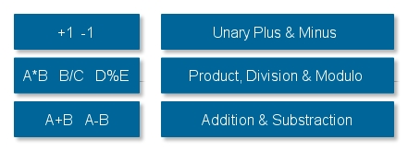
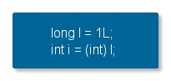
Arithmetic Operators
left associative with normal precedence
JVM calculates using int, long, float or double
byte and short widened to int
use casts to "narrow" or "widen" a numeric value
cast syntax: (type)
may lose range or precision

Slide 49
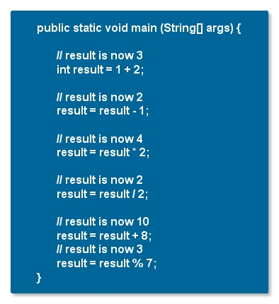
Example

Slide 50
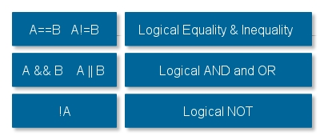
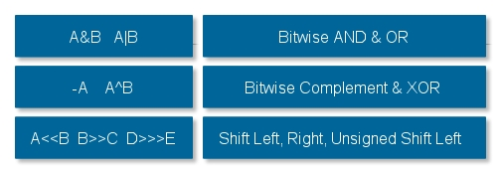
Logical and Bitwise Operators
logical expressions yield boolean values
lower precedence than arithmetic operators
short-circuit evaluation, stops when result is known
bitwise operators manipulate bits in int and long

Slide 51
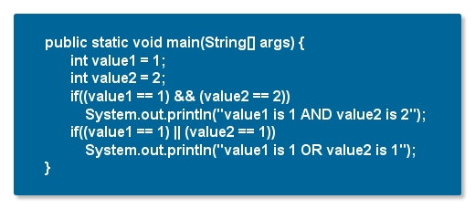
Example

Slide 52
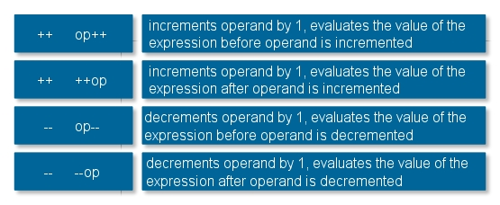
Miscellaneous Operators
conditional (ternary) operator
cond expression1 ? true_expression : false_expression;
increment and decrement operators
available in prefix or postfix form

Slide 53
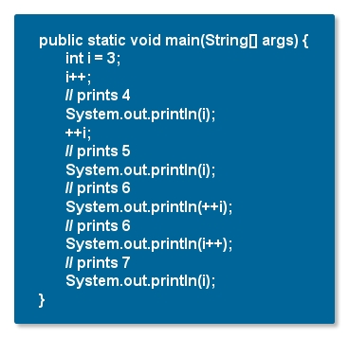
Example

Slide 54
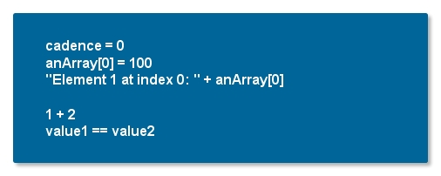
Expressions
xpression is a construct made up of
variables
operators
method invocations
constructed according to the syntax of the language

Slide 55
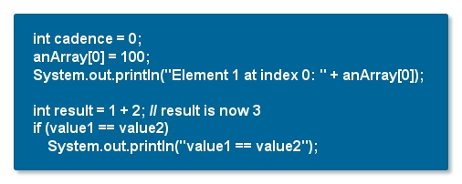
Statements
statement forms a complete unit of execution
following types of expressions can be made into a statement by terminating the expression with a semicolon (;)
assignment expressions
any use of ++ or --
method invocations
object creation expressions

Slide 56
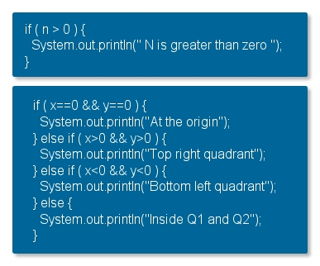
Control Flow Statements - if
he else clause is optional, and may be also followed by another if statement
the statements can be compound block statements
expression must yield a boolean value.

Slide 57
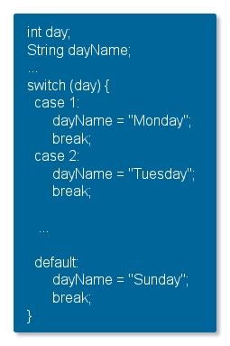
Control Flow Statements - switch
expression must yield ordinal or enumerated type
Java 7: String based switch statement
body of a switch statement: switch block
one or more case or default labels
break statement: terminates the enclosing switch statement
lack of break: fall through
default section: handles all values that are not explicitly handled

Slide 58
Control Flow Statements - looping
main forms of loop control flow:
for loop
while loo
do/while loop
break is used to terminate a loop
continue is used to force a loop into the next iteration

Slide 59
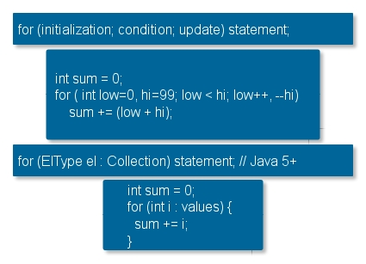
Control Flow Statements – for Loop
for statement provides a compact way to iterate over a range of values
when using this version of the for statement
initialization expression initializes the loop; it's executed once,
as the loop begins when termination expression evaluates to false, the loop terminates
increment expression is invoked after each iteration

Slide 60
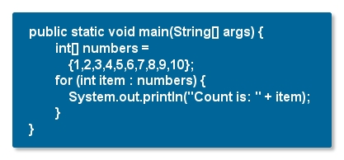
Control Flow Statements foreach Loop
for statement also has another form designed for iteration through
Collections
arrays
form is sometimes referred to as the enhanced for statement
more compact
easy to read

Slide 61
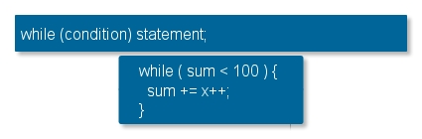
Control Flow Statements - while Loop
while statement evaluates condition expression
must return a boolean value
while statement continues testing the expression and executing its block until the expression evaluates to false
you can implement an infinite loop using the while statement

Slide 62
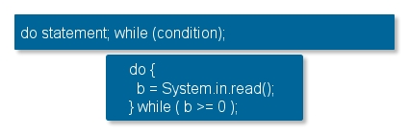
Control Flow Statements - do/while Loop
difference between do-while and while
do-while evaluates its expression at the bottom of the loop
statements within the do block are always executed at least once

Slide 63



Comments
comments are not part of the program itself - does not affect the programming logic
used only for documentation
comments out the rest of the line
comments out several lines (no nesting)
comment to semi-automate code documentation
recognised by javadoc standard utility (and by many IDEs real-time)

Slide 64
Table of Contents
Getting Started with Java
Introduction to Eclipse IDE
Objects and Classes
Using Java Objects
Inheritance, Abstract Classes and Interfaces
Inner Classes
Exceptions
Collections and Generic Types
Java I/O
Java Annotation
JMX
JConsole
Regular Expressions

Slide 65
2. Introduction to Eclipse IDE
Eclipse Overview
Eclipse in Action

Slide 66
Eclipse Overview
Integrated Development Environment (IDE)
written mostly in Java
download it
https://www.eclipse.org/downloads/
no need of installation
downloaded archive should be extracted
to start eclipse, run eclipse executable (in root dir)
needs a Java Runtime Environment to run
ready for using Eclipse!

Slide 67
Eclipse in Action
DEMO

Slide 68
Table of Contents
Getting Started with Java
Introduction to Eclipse IDE
Objects and Classes
Using Java Objects
Inheritance, Abstract Classes and Interfaces
Inner Classes
Exceptions
Collections and Generic Types
Java I/O
Java Annotation
JMX
JConsole
Regular Expressions

Slide 69
Objects and Classes
Defining a Class
Creating an Object
Object Initialization
The Constructor
Parameter Passing
The Current Object
Class Members
Working with Objects

Slide 70
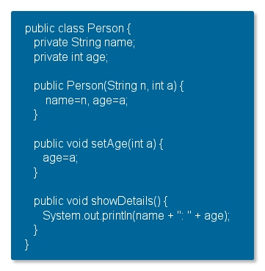
Defining a Class
basic concept in OO: object
objects with same type belong to the same class
class includes a special method, a constructor
used to initialise an object of the class as it is being created

Slide 71

Creating an Object
objects contains
identity
state
behaviour
creating object: new operator
returns a reference
declaring a variable of a class type (that is, reference variable) does not create an object.
you can have more than one reference to an object.

Slide 72

Object Initialization
objects created with new operator
attributes set to default values
0 for numeric/char primitive types
false for boolean
null for objects
class specific initial values then set
constructor called for more detailed initialisation

Slide 73

The Constructor
pseudo-method to initialise newly created object
same name as class, no return type
may be overloaded
correct constructor called according to argument list used with new
default "no-arg" constructor provided
unless class contains other constructors
call another constructor with this([<parameter list>])

Slide 74
Parameter Passing
parameters refers to the list of variables in a method declaration
arguments are the actual values that are passed in when the method is invoked
when you invoke a method, the arguments used must match the declaration's parameters in type and order.
parameter types
any data type for a parameter of a method or a constructor
Java programming language doesn't let you pass methods into methods
you can pass an object into a method and then invoke the object's methods
you declare a parameter to a method or a constructor
you provide a name for that parameter
name is used within the method body to refer to the passed-in argument
name of a parameter must be unique in its scope

Slide 75
Parameter Passing cont’d
passing primitive data type arguments
passed into methods by value
copy of the primitive is sent into the method
passing reference data type arguments
passed into methods by value
copy of the reference is sent into the method
values of the object's fields can be changed in the method

Slide 76

The Current Object
this reference
available in constructor and methods
not static methods ( like main )
often used to avoid possible ambiguity

Slide 77

Class Members
use of the static keyword
create fields that belong to the class, rather than to an instance of the class
create methods that belong to the class, rather than to an instance of the class
class variable
static fields or class variables
common to all objects
class variables are referred to by the class name itself, as in
Bicycle.numberOfBicycles

Slide 78

Class Members cont’d
class methods
have the static modifier in their declarations
should be invoked with the class name
without the need for creating an instance of the class
class methods can access class variables and class methods directly
class methods cannot access instance variables or instance methods directly

Slide 79

Example

Slide 80

Working with Objects
use the '.' operator to access methods and attributes
subject to visibility rules defined in class
beware of assignment
assigns reference, not object!

Slide 81
Table of Contents
Getting Started with Java
Introduction to Eclipse IDE
Objects and Classes
Using Java Objects
Inheritance, Abstract Classes and Interfaces
Inner Classes
Exceptions
Collections and Generic Types
Java I/O
Java Annotation
JMX
JConsole
Regular Expressions

Slide 82
Using Java Objects
Strings
Dates
Comparing and Identifying Objects
Object Lifetime
Wrapper Classes
Autoboxing and -unboxing
Enumerated Types

Slide 83


Strings
built in class type
strings are sequences of Unicode characters
language provides syntax shortcuts for working with Strings
String objects are immutable
many methods defined in String

Slide 84
Working with Strings
possible tasks involving String objects including but not limited to
manipulating (modifying)
StringBuilder
parsing
StringTokenizer and StreamTokenizer classes
Scanner class
Pattern and Matcher classes
formatting
System.out.printf
PrintWriter.printf
printing
System.out.println

Slide 85

The StringBuilder Class
mutable objects
non-thread safe (thread-safe equivalent: StringBuffer )
should generally be prefered to StringBuffer
create String object from StringBuilder objects
toString()

Slide 86


Parsing Texts
StringTokenizer
Scanner

Slide 87
Formatting Strings
formatting strings: System.out.printf(...), PrintWriter.printf(...)
first argument is the format string
common conversion characters
b - boolean
s - String
d - decimal integer
x - hex integer
f - decimal floating point
a - hex floating point
n - line separator
common flags
- - left justify
+ - signed
0 - zero padded
( - negative numbers in parenthesis

Slide 88


Example

Slide 89
Dates
java.util.Date
most of the methods are deprecated
bridge between the Calendar and DateFormat classes
mutable date and time, to a millisecond
java.util.Calendar
convert and manipulate dates and times
java.util.GregorianCalendar is a concrete subclass
java.text.DateFormat
format dates
can handle locales
java.text.SimpleDateFormat is a concrete subclass
java.util.Locale
used with DateFormat and NumberFormat
format dates, numbers, and currencies for specific locale

Slide 90

Format Date
use SimpleDateFormat to format a date
for example today’s date in ‘dd/MM/yy’ format

Slide 91

Working with Dates and Calendars
java.util.Calendar: abstract encapsulation of the object Date
concrete implementation: java.util.GregorianCalendar
getters and setters for date fields
calendar field access
Calendar.YEAR - identifies the year
Calendar.MONTH - identifies the month
Calendar.DAY_OF_MONTH - identifies the day
Calendar.HOUR - identifies the hour
Calendar.MINUTE - identifies the minute
Calendar.SECOND - identifies the second

Slide 92


Comparing and Identifying Objects
are required when comparing objects
normal == operator compares reference identity
class Object defines equals method
determines whether objects are to be considered equal
conditions for equality are defined by class designer

Slide 93
Hash Code
during an execution of a Java application
hashCode method must consistently return the same object as long as its inner states are not changed
if two objects are equal according to the equals(Object) method, then calling the hashCode method on each of the two objects must produce the same integer result
it is not required that if two objects are unequal according to the equals(Object) method, then calling the hashCode method on each of the two objects must produce distinct integer results
producing distinct integer results for unequal objects may improve the performance of hash tables
by default implemented by converting the internal address of the object into an integer

Slide 94
Object Lifetime
object "lives" as long as someone references it
space reclaimed for the heap by the garbage collector
finalize() method called after garbage collector reclaims object
if defined in object's class
designed to contain clean-up functionality
garbage collection is unpredictable
may not even happen
finalize() may never be called

Slide 95
Object Creation
creating objects is expensive.
you instantiate an object the following steps occur:
Memory is allocated.
Instance fields are set to their default values.
Any initialization blocks are called.
The object’s constructor is called.
The object’s super constructor is called.
Superclass instance fields are given their specified values.
The body of the superclass constructor is called.
prefer primitives to their wrapper class counterparts
primitives perform always better than their corresponding wrappers

Slide 96
Garbage Collection
the Java Virtual Machine maintains two sections of memory during the program execution: the stack and the heap.
automatic garbage collection
process of looking at heap memory
identifying which objects are in use and which are not
deleting the unused objects
unused object
no longer referenced by any part of your program
no keyword for deallocating memory
deallocating memory is handled automatically by the garbage collection

Slide 97

Wrapper Classes
primitive types are not classes
primitive variables are not objects
they do not need to be instantiated
they do not have methods
wrappers give primitive object behaviour (immutable)
used when primitives cannot be used (eg. in collection classes)
conversion to and from wrapper objects is done by
explicit conversion (Integer.valueOf(), Integer.intValue())
autoboxing, -unboxing (since Java 5)

Slide 98


Autoboxing and Unboxing
Java 5 offers transparent conversion from primitive type to wrapper …
autoboxing
… and back too
unboxing
allows arithmetic on wrapper objects

Slide 99

Autoboxing and Unboxing cont’d
Java specification requires certain “optimization”
certain primitives always boxed into the same immutable wrapper objects
true/false, values between -128 and 127, char values \u0000 to \u007f
can make comparison seem odd

Slide 100


Enumerated Types
enum keyword
since Java 5
typesafe enumeration of values
example
can be used in switch statements
enum declaration generates a new class behind the scenes

Slide 101
Enumerated Types cont’d
the enum declaration defines a class (called an enum type)
the enum class body can include methods and other fields
some special methods when an enum is created
static values method that returns an array containing all of the values of the enum in the order they are declared
commonly used in combination with the for-each construct to iterate over the values of an enum type
constants defined inside Enum in Java are final you can safely compare them using "==" equality operator
new collection classes EnumMap and EnumSet are added into collection package to support Java Enum
high performance implementation of Map and Set interface

Slide 102
Table of Contents
Getting Started with Java
Introduction to Eclipse IDE
Objects and Classes
Using Java Objects
Inheritance, Abstract Classes and Interfaces
Inner Classes
Exceptions
Collections and Generic Types
Java I/O
Java Annotation
JMX
JConsole
Regular Expressions

Slide 103
Inheritance, Abstract Classes and Interfaces
Inheritance in Java
Casting
final Modifier
Method Overriding and Polymorphism
Abstract Classes
Interfaces

Slide 104
Inheritance in Java
inheritance is a mechanism for defining a new class upon an existing class
subclass, superclass
subclass may add new states and behaviour
subclass may override methods
constructors are not inherited
inheritance allows the refinement or specialisation of an existing class
e.g. Circle is subclass of Shape
inherited members can be redefined
access class of inherited members can not be narrowed
new members can be added
Inheritance is the key feature of object-oriented systems to promote software reuse
is the source of “is a” or “kind of” relationship

Slide 105

Inheritance in Java
extends keyword indicates that a class inherits state and behaviour of another class
Java class can inherit from only one superclass (super)
every class implicitly extends Object class
final classes cannot be extended (eg. java.lang.String)
potentially adds new
data and methods
may redefine existing
methods

Slide 106
Deadly Diamond of Death
java programming language does not permit you to extend more than one class
to avoid the issues of multiple inheritance of state
the ability to inherit fields from multiple classes
the ability to inherit method definitions from multiple classes

Slide 107

Deadly Diamond of Death cont’d

Slide 108

Method Inheritance
a subclass inherits members from the superclass
all non-private methods and variables of the parent are inherited
locally defined method hides method in parent
both methods are nevertheless available for the class
use the keyword super to explicitly refer to the superclass method

Slide 109

Constructor of Superclasses
subclasses must construct the superclass
automatic if the superclass has a default constructor
otherwise, must use super() to call a specific constructor
super() must be the first statement in the constructor

Slide 110


Casting
a variable can refer to an object of its own type or one of a subtype of its own type
upcasting: object returned by the new operator is implicitly casted to a Person (superclass of Employee) before the assignment
downcasting: explicitly casting a reference of a superclass to one of its subclass
if p does not refer to an Employee (or a descendent): ClassCastException
use instanceof operator to avoid

Slide 111

Final Modifier
the final modifier on classes
prevents the class from being extended
can improve compiler and runtime optimisation
the final modifier on methods
prevents a method being overridden in derived classes
the final modifier on variables
makes the “variable” constant
fixes the value of a variable for its lifetime
must be supplied with an initial value

Slide 112
Method Overriding and Polymorphism
overriding occurs when the subclass defines the same method as the superclass did
method signatures must be identical
returned value type must be identical
access class cannot be narrowed
Virtual Machine uses dynamic lookup to determine which method to invoke
the method called depends on the datatype of the target object
dynamic binding or polymorphism
frequently used when working with collections of objects
create objects of different (but related) types and manage them all in the same way
the code that manages the objects and sends messages to them does not need to know the exact datatypes of the individual objects

Slide 113

Example

Slide 114


Abstract Classes
an abstract class is a class that is declared abstract
it may or may not include abstract methods
cannot be instantiated
can be subclassed.
an abstract method is a method that is declared without an implementation (without curly brackets and followed by a semicolon)
if a class includes abstract methods, then the class itself must be declared abstract

Slide 115
Abstract Classes cont’d
when an abstract class is subclassed
the subclass usually provides implementations for all of the abstract methods in its parent class
if it does not, then the subclass must also be declared abstract
consider using abstract classes if
you want to share code among several closely related classes
you expect that classes that extend your abstract class have many common methods or fields
you want to declare non-static or non-final fields, this enables you to define methods that can access and modify the state of the object to which they belong
abstract class may have static fields and static methods

Slide 116

Interfaces
interfaces: abstract types with no implementation
all methods are implicitly public
all methods are implicitly abstract - no default behaviour
all variables are implicitly public static final - must be initialised
unlike abstract classes, interfaces reside in a separate inheritance hierarchy
classes can implement multiple interfaces
interfaces can be extended (interface inheritance)

Slide 117


Interfaces cont’d
consider an interface that you have developed
you want to add an additional method to it
all classes that implement the old interface will break because they no longer implement the old interface
extending interface
multiple inheritance is supported

Slide 118
Interface vs. Abstract Classes
use abstract class if
you will plan on using inheritance since it provides a common base class implementation to derived classes
you want to be able to declare non-public members (in an interface, all methods must be public)
you think you will need to add methods in the future
use interface if
you think that the API will not change for a while
you want to have something similar to multiple inheritance

Slide 119
Lab 5

Slide 120
Table of Contents
Getting Started with Java
Introduction to Eclipse IDE
Objects and Classes
Using Java Objects
Inheritance, Abstract Classes and Interfaces
Inner Classes
Exceptions
Collections and Generic Types
Java I/O
Java Annotation
JMX
JConsole
Regular Expressions

Slide 121
Inner Classes
What are Inner Classes?
Nested Classes
Member Classes
Anonymous Classes

Slide 122
What are Inner Classes?
class and Interface definitions may be nested
local to other classes or interfaces (member classes)
local to methods (anonymous classes)
local to blocks of code (member classes)
static or non-static (nested or member classes)
nested types are members of enclosing type
share access to all other members
useful for many purposes
expressing structural relationship between types
defining tight relationships between objects

Slide 123

Nested Classes
class declared as static member of enclosing class
provides visibility control over definition
no relationship between instances of outer & inner class
compiled to separate class file
Outer$Inner.class

Slide 124

Member Class
non static nested class
declared as member of the enclosing class
access to all other members
including private
instance of inner class bound to instance of enclosing class
cannot have inner object without outer object
can have outer object without inner object
member class can only be instantiated relative to instance of outer object
subject to visibility
use variant of new operator for this
member classes have access to other members of the enclosing class, even if they are declared private
this reference refers to inner class object

Slide 125

Member Classes cont’d

Slide 126

Anonymous Classes
like local class but without a name
used for functionality only needed in one place
defined and instantiated in one step
implements interface
extends another class
compiled to separate class file
Outer$1.class
etc.

Slide 127
Lab 6

Slide 128
Table of Contents
Getting Started with Java
Introduction to Eclipse IDE
Objects and Classes
Using Java Objects
Inheritance, Abstract Classes and Interfaces
Inner Classes
Exceptions
Collections and Generic Types
Java I/O
Java Annotation
JMX
JConsole
Regular Expressions

Slide 129
Inner Classes
What are Exceptions?
Catching Exceptions
Declaring Exceptions
Exception Types
The finally Block
Throwing Exceptions
User Defined Exceptions
Exception and Overriding
Bad Practices with Exceptions
Benefits of Exception Handling
Checked or Unchecked Exceptions?

Slide 130
What are Exceptions?
represents an exceptional event - an error that occurs during runtime
may indicate an error, or just something unusual
allows controlled management of errors
Java exceptions are objects
classes form an extensible exception hierarchy
directly supported in the language and VM
may be caught and …
handled (immediately), or
propagated (delayed)

Slide 131
What are Exceptions? cont’d
when an error occurs within a method
the method creates an object
hands it off to the runtime system
the exception object
contains information about the error
its type
the state of the program when the error occurred
after a method throws an exception
the runtime system attempts to find something to handle it
the ordered list of methods that had been called to get to the method where the error occurred
the list of methods is known as the call stack

Slide 132

What are Exceptions? cont’d

Slide 133

What are Exceptions? cont’d
runtime system searches the call stack
method that contains a block of code that can handle the exception
exception handler
when an appropriate handler is found, the runtime system passes the exception to the handler

Slide 134

Catching Exceptions
One way to call a method that throws an exception is to create a try block and a catch block. The structure looks like this:
getMessage() and printStackTrace() methods
try block may contain code, that throws different exception types

Slide 135

Multi-catch Exceptions
in Java 7 and later, a single catch block can handle more than one type of exception
reduce code duplication
lessen the temptation to catch an overly broad exception
if a catch block handles more than one exception type, then the catch parameter is implicitly final

Slide 136

Declaring Exceptions
call exception-throwing methods without enclosing the calls in a try blocks
a method throws an exception
an exception object is created
handed off to the JVM
each catch block following that try block is checked, for compatibility with the exception
checking compatibility: instanceof operator

Slide 137

Exception Types
two kinds of exception: checked and unchecked
Errors, which appear on the right side of the figure, behave just like other checked exceptions. However, programmers should never throw or catch errors, which mostly are reserved for indicating trouble in JVM.

Slide 138
The finally Block
last catch block associated with a try block may be followed by a finally block
you can use a try block without associated catch, if it has a finally block
often used for locks in concurrent packages
finally block’s code is guaranteed to execute in nearly all circumstances
whenever the execution leaves the try-construct
here’s what it takes to prevent a finally block from running to completion
The death of the current thread
Execution of System.exit()
Turning off the computer

Slide 139

The try-with-resources Statement
a try statement that declares one or more resources
resource is an object that must be closed after the program is finished with it
all object that implements java.lang.AutoCloseable can be used as a resource
prior to Java SE 7, you can use a finally block to ensure that a resource is closed
you may declare one or more resources in a try-with-resources statement

Slide 140

Throwing Exceptions
the methods that you write can throw exceptions.
construct an instance of your chosen exception type
use the throw keyword
checked exception types thrown from a method must be represented in the method’s “throws” list.

Slide 141


User Defined Exceptions
new exception types can be defined
allow specific error conditions to be identified
mostly checked exceptions
exceptions can be thrown from any part of code
it is good practice to append the string Exception to the names of all classes that inherit (directly or indirectly) from the Exception class

Slide 142

Exceptions and Overriding
When you extend a class and override a method, the Java compiler insists that all exception classes thrown by the new method must be the same as, or subclasses of, the exception classes thrown by the original method.

Slide 143


Bad Practice with Exceptions
exception swallowing
empty handler
exception “disappears”
often compounded by catch blocks for top level exception classes

Slide 144
Benefits of Exception Handling
separating error-handling code from "regular" code
provide the means to separate the details of what to do when something out of the ordinary happens from the main logic of a program
propagating errors up the call stack
exception need not be fully handled where it occurs
declare method as throwing exception
now caller must deal with exception
grouping and differentiating error types
grouping or categorizing of exceptions is a natural outcome of the class hierarchy

Slide 145
Checked or Unchecked Exceptions?
loads of debates over the value of checked exceptions
original idea was to force programmers to think about error/unexpected conditions
large applications have many different checked exceptions to deal with
proliferation of catch blocks can obscure meaning of code
leads to bad practices
newer frameworks tend to use unchecked exceptions
Spring
often provide scope to translate checked exceptions to unchecked

Slide 146
Lab 7

Slide 147
Table of Contents
Getting Started with Java
Introduction to Eclipse IDE
Objects and Classes
Using Java Objects
Inheritance, Abstract Classes and Interfaces
Inner Classes
Exceptions
Collections and Generic Types
Java I/O
Java Annotation
JMX
JConsole
Regular Expressions

Slide 148
Collections and Generic Types
Collection Framework
The Collection Superinterface
Lists
Sets
Maps
Iterator Interface
Support Classes
Collections and Generic Types
Ordering Within Collection
Generic Types
Type Erasure
Generic Methods

Slide 149

Collection Framework
flexible and powerful mechanism for handling collections of objects
based on interfaces

Slide 150
Framework Requirements on Objects
collection elements are objects
use wrapper classes for primitive types
behavioural contract for objects in collections
otherwise collection behaviour not guaranteed
objects compared using equals() method
return true if o1 == o2
return false if !( o2 instanceof o1 )
determine equality by checking fields
if o1.equals(o2) then o2.equals(o1)
hashCode() method also used
must be implemented in line with equals() method
if o1.equals(o2) then o1.hashCode() == o2.hashCode()

Slide 151
The Collection SuperInterface
The most abstract interface is the Collection interface, this represents a group of objects that may contain duplicates.
add(Object x) - Adds x to this collection.
addAll(Collection c) - Adds every element of c to this collection.
clear() - Removes every element from this collection.
contains(Object x) - Returns true if this collection contains x.
containsAll(Collection c) - Returns true if this collection contains every element of c.
isEmpty() - Returns true if this collection contains no elements.
iterator() - Returns an Iterator over this collection.
remove(Object x) - Removes x from this collection.
removeAll(Collection c) - Removes every element in c from this collection.
retainAll(Collection c) - Removes from this collection every element that is not in c.
size() - Returns the number of elements in this collection.
toArray() - Returns an array containing the elements in this collection

Slide 152
Lists
provides an ordered collection of objects
elements can be accessed using integer index
user has control over where elements are added
rather like a variable length array
void add(int index, Object x)
Object get(int index)
int indexOf(Object x)
Object remove(int index)
common implementations
Vector
Stack
ArrayList
LinkedList

Slide 153

Sets
provides a collection with no duplicate elements
no ordering or position information for elements
may or may not allow null elements
depends on implementation
HashSet
Set interface implemented using a hash table
doesn't guarantee to iterate the elements in any specific order
constant time access to elements assuming good hash function
TreeSet
Set interface implemented as a tree
concept of natural order

Slide 154
Maps
java.util.Map
stores values against keys
put(Object key, Object value) and get(Object key)
separate from Collection interface
common methods
Object put(Object key, Object value)
Object get(Object key)
boolean containsKey(Object key)
void clear()
Set keySet()
Collection values()
Java’s two most important Map classes are java.util.HashMap and java.util.TreeMap.

Slide 155
Iterator Interface
abstract mechanism for traversing a Collection
defines hasNext() and next() methods
throws ConcurrentModificationException if underlying collection is modified
also provides remove() method
Collections support iterator() method to return
object that implements interface

Slide 156

Support Classes
Collections class
creating Collections from existing ones
efficient locking strategies
high performance

Slide 157

Collections and Generic Types
from Java 5
objects retrieved from generic collections need not be cast
generic types give greater type safety in collections
Raw Types and Type Erasure
note generic type syntax
<?> means any type
<? extends E> means any subtype of E

Slide 158

Ordering within Collection
classes may have ordering criteria
allows sorting functionality
supports collections that maintain order
contract of compareTo():
return -1 if o less than this
return 0 if o is "equal to" this
return 1 if o is greater than this
natural ordering may be "consistent with equals"
(x.equals(y)) ==
(x.compareTo(y) == 0)
usually true but not always
- java.math.BigDecimal

Slide 159

Generic Types
generic type
generic class or interface
parameterized over types

Slide 160
Generic Types cont’d
type variable can be any non-primitive type you specify
any class type
any interface type
any array type
enumerations
even another type variable
commonly used type parameter names
E - Element (used extensively by the Java Collections Framework)
K - Key
N - Number
T - Type
V - Value
S,U,V etc. - 2nd, 3rd, 4th types

Slide 161


Generic Types cont’d
reference the generic Box class
perform a generic type invocation
replaces T with some concrete value
the T in Box<T> is a type parameter and the Integer in Box<String> is a type argument
invocation of a generic type is generally known as a parameterized type.
to instantiate this class
use the new keyword
place <Integer> between the class name and the parenthesis

Slide 162

Generic Types cont’d
a generic class can have multiple type parameters
the diamond
Java SE 7 and later
can replace the type arguments with empty set of type arguments (<>)
as long as the compiler can determine the type arguments from the context

Slide 163
Raw Types and Compatibility
raw type
name of a generic class or interface
without any type arguments
collection types all modified to be generic types
pre-Java 5 code will still work
generic types become raw types
Java 5 compiler will issue warnings
raw types bypass generic type checks
deferring the catch of unsafe code to runtime
you should avoid using raw types.

Slide 164
Type Erasure
generics
tighter type checks at compile
support generic programming
Java compiler applies type erasure
replace all type parameters in generic types with their bounds or Object if the type parameters are unbounded
produced bytecode contains only ordinary classes, interfaces, and methods
insert type casts if necessary to preserve type safety
generate bridge methods to preserve polymorphism in extended generic types
type erasure ensures that no new classes are created for parameterized types
generics incur no runtime overhead

Slide 165

Generic Methods
generic methods
introduce their own type parameters
similar to declaring a generic type
the type parameter's scope is limited to the method where it is declared
static and non-static generic methods are allowed
syntax for a generic method
type parameter inside angle brackets
type parameter appears before the method's return type

Slide 166
Bounded Type Parameters
you want to restrict the types that can be used as type arguments in a parameterized type
method that operates on numbers might only want to accept instances of Number or its subclasses
to declare a bounded type parameter
list the type parameter's name
followed by the extends keyword
followed by its upper bound
extends is used in a general sense
"extends" (as in classes)
"implements" (as in interfaces)

Slide 167

Bounded Type Parameters cont’d

Slide 168


Multiple Bounds
type parameter can have multiple bounds
type variable with multiple bounds is a subtype of all the types listed in the bound
if one of the bounds is a class, it must be specified first

Slide 169
Lab 8

Slide 170
Table of Contents
Getting Started with Java
Introduction to Eclipse IDE
Objects and Classes
Using Java Objects
Inheritance, Abstract Classes and Interfaces
Inner Classes
Exceptions
Collections and Generic Types
Java I/O
Java Annotation
JMX
JConsole
Regular Expressions

Slide 171
Java I/O
Streams, Readers, and Writers
File Input and Output
Object Streams and Serialization
Versioning of Serializable Objects
“New I/O” or NIO

Slide 172

Streams, Readers and Writers
a stream is a sequence of bytes.
input streams obtain bytes from an external source
output streams move bytes to an external target
streams can be used to communicate between Java threads
streams are used to transfer data as bytes
Reader obtains character data
convert bytes to characters using appropriate conversion
Writer outputs character data
convert Unicode characters to bytes according to local conversion rules

Slide 173
Standard Streams
Java provides 3 standard I/O streams
System.in InputStream for standard input
System.out PrintStream for standard output
System.err PrintStream for standard error output
construct a Reader object from System.in for input
use buffered I/O for efficiency
BufferedReader
BufferedWriter
BufferedInputStream
BufferedOutputStream

Slide 174

I/O Example

Slide 175
File Input and Output
read files with FileReader or FileInputStream
constructor uses filename or File object
can throw FileNotFoundException
reading methods return -1 or null on EOF
write to files using FileWriter or FileOutputStream
constructor uses filename or File object
can throw IOException when creating file (e.g. disk full)
use close() method to end an I/O stream
avoid closing an already closed stream
GUI applications can use FileDialog / JFileChooser

Slide 176
File Input and Output cont’d
file class encapsulates file information
think of File objects as holding file path names, not files
hides details of directory and file separator characters
contains useful file and directory methods
canRead() file is readable
canWrite() file is writeable
canExecute() file is executable
exists() file exists
delete() delete file
isDirectory() tests if a name is a directory
length() size of file
list() list all files in a directory as String[]
mkdir() creates a directory
lastModified() time&date of last change as a Date

Slide 177
Object Stream and Serialization
data input and output streams
reading and writing primitives and strings
object streams
reading and writing objects
the process of writing an object
serialization
need an instance of java.io.ObjectOutputStrem
serialization and deserialization
transient fields
a class that might be serialized should implement
Serializable interface

Slide 178
Versioning of Serializable Objects
Java serialization provides a serialVersionUID (suid)
for version control
in the ObjectStreamClass
suid is used to inform the Java serialization mechanism which version of the class is compatible with this serialized object
the Java serialization mechanism automatically computes a hash value
ObjectStreamClass's computeSerialVersionUID method passes the
class name
sorted member names
modifiers
Interfaces
to the secure hash algorithm (SHA), which returns a hash value

Slide 179
“New I/O” or NIO
many additions to I/O facilities
"New I/O"
low-level I/O operations
channels and buffers
memory mapped I/O
non-blocking I/O
much improved performance
file locking
shared and exclusive locks

Slide 180
Lab 9

Slide 181
Table of Contents
Getting Started with Java
Introduction to Eclipse IDE
Objects and Classes
Using Java Objects
Inheritance, Abstract Classes and Interfaces
Inner Classes
Exceptions
Collections and Generic Types
Java I/O
Java Annotation
JMX
JConsole
Regular Expressions

Slide 182
Java Annotation
Annotation in Java 5
Defining a New Annotation Type
Annotating Annotation Types
Inheriting Annotations
Working with Annotations

Slide 183

Annotations in Java 5
major enhancement to the language
modifiers that can be added to code
package declarations
type declarations
constructors
methods
fields
parameters
variables
standard annotations supplied
also framework for user defined annotations
access to annotations for processing tools

Slide 184

Defining a New Annotation Type
one more type available in Java 5
defined using @interface

Slide 185

Default Values
in some cases, it is convenient to include values that have a default in an annotation
"default" keyword

Slide 186

Annotating Annotation Types
allows annotation to be better targeted
compiler can check for correct usage
@Target meta-annotation
specifies entities to which annotation can be applied

Slide 187
Inheriting Annotations
@Inherited meta-annotation
marker
specifies that annotation is inherited by subclasses
default is not to inherit

Slide 188
Working with Annotations
use reflection APIs to retrieve details of annotations
requires RetentionPolicy.RUNTIME
not always efficient
process source files for annotations
perform additional validation
generate configuration files automatically
rewrite source code to add boilerplate code
add instrumentation
getAnnotation() checks for specific annotation
returns instance of annotation type or null
getDeclaredAnnotations() returns all annotations

Slide 189

Example

Slide 190
Table of Contents
Getting Started with Java
Introduction to Eclipse IDE
Objects and Classes
Using Java Objects
Inheritance, Abstract Classes and Interfaces
Inner Classes
Exceptions
Collections and Generic Types
Java I/O
Java Annotation
JMX
JConsole
Regular Expressions

Slide 191
JMX
Architecture of the JMX Technology
Monitoring and Management of the JVM

Slide 192
Architecture of the JMX Tech.
The Java Management Extensions (JMX) technology is a standard part of the Java Platform, Standard Edition (Java SE platform).
The JMX technology provides a simple, standard way of managing resources such as applications, devices, and services.
The JMX technology can be divided into three levels, as follows:
Instrumentation
JMX agent
Remote management
The core component of a JMX agent is the MBean server.

Slide 193
Monitoring and Management of JVM
The Java VM has built-in instrumentation that enables you to monitor and manage it by using the JMX technology.
The platform MXBeans are a set of MXBeans that is provided with the Java SE platform for monitoring and managing the Java VM.

Slide 194
Table of Contents
Getting Started with Java
Introduction to Eclipse IDE
Objects and Classes
Using Java Objects
Inheritance, Abstract Classes and Interfaces
Inner Classes
Exceptions
Collections and Generic Types
Java I/O
Java Annotation
JMX
JConsole
Regular Expressions

Slide 195
JConsole
Starting JConsole
Setting up Local Monitoring
Setting up Remote Monitoring
Connect to a JMX Agent
The JConsole Interface

Slide 196
JConsole
The jconsole executable can be found in JDK_HOME/bin
You start JConsole by typing the following command at the command line.
jconsole
The command syntax to start JConsole for local monitoring of a specific application is the following.
jconsole processID
To start JConsole for remote monitoring, you use the following command syntax.
jconsole hostName:portNum

Slide 197

Connecting to JMX Agent
If you do not provide any arguments when you start jconsole, the first thing you see is the connection dialog box. This dialog box has three tabs:
Local
Remote
Advanced
The local tab lists any JVMs running on the local system
To monitor a remote JVM, enter:
Host name: name of the machine on which the JVM is running.
Port number: the JMX agent port number you specified when you started the JVM.
User name and password: the user name and password to use
The advanced tab enables you to connect to other JMX agents (MBean servers) by specifying their JMX URL, and the user name and password.

Slide 198

The JConsole Interface
The jconsole interface is composed of six tabs:
Summary tab: displays summary information on the JVM and monitored values.
Memory tab: displays information on memory use.
Threads tab: displays information on thread use.
Classes tab: displays information on class loading
MBeans tab: displays information on MBeans
VM tab: displays information on the JVM

Slide 199
Table of Contents
Getting Started with Java
Introduction to Eclipse IDE
Objects and Classes
Using Java Objects
Inheritance, Abstract Classes and Interfaces
Inner Classes
Exceptions
Collections and Generic Types
Java I/O
Java Annotation
JMX
JConsole
Regular Expressions

Slide 200
Regular Expressions
Regular Expressions in Java
Regular Expression Syntax
Special Characters
Quantifiers
Assertions
The Pattern Class
The Matcher class

Slide 201
Regular Expressions in Java
In Java, the tools for using REs are found primarily in two classes, both in java.util.regex.
The Pattern class.
The Matcher class.
The Pattern and Matcher classes work together.
// Determine if the pattern ERROR occurs in a line
Pattern p = Pattern.compile(“ERROR”);
Matcher m = p.matcher(“Abort: ERROR 339 has occured”);
boolean result = m.find();

Slide 202
Regular Expression Syntax
comprehensive syntax for specifying patterns of text
^ metacharacter: a pattern must start at the beginning of the string
period metacharacter (.): matches any single character.
The RE "12." matches any three-character sequence starting with "12":
"125"
"As simple as 123"
"The address is 7412 Main Street." - What matches?
"Today I turned 12” - Why does this not match?

Slide 203
Special Characters
\w (word character)
\s (whitespace character), \S matches any non-space character
\d {digit character) , \D matches any non-digit character
[A-Za-z_0-9] is the same as \w
[\n\r\f\t ] is the same as \s
[0-9] is the same as \d

Slide 204
Quantifiers
* - matches any number, even zero, of the preceding RE character.
+ - matches one or more of the preceding RE character.
? - matches either zero or one of the preceding RE character.
You can specify any quantity of an RE character by using {}
{n}
{n,}
{n,m}

Slide 205
Assertions
Assertions anchor a pattern to a specific location in a string. ^ and $ anchor a pattern to the beginning or ending, respectively, of a string.
^s\d - Matches a line starting with s followed by a digit.
sh$ - Matches a line ending with sh.

Slide 206
The Pattern Class
Use Pattern.compile(String regex) or Pattern.compile(String regex, int flags) to create a pattern object. Some of the flags are:
CASE_INSENSITIVE - Allows case-insensitive matching.
COMMENTS - Allows whitespace and comments in a pattern.
MULTILINE - Searches for patterns in a multiline string.
The following will match "CAT", "Cat", "cat", etc. ..
Pattern p = Pattern. compile ("cat”, Pattern.CASE_INSENSITIVE) ;
The flags() method returns which flags are set for a pattern.
int f1 = p.flags();
The pattern() method returns the regular expression.
String re = p.pattern();

Slide 207
The Matcher Class
Matcher class: return data about a previous match.
start() - returns the start index of the previous match.
end() - returns the index of the last character matched, plus one.
group() - returns the string which was previously matched by the pattern.
replaceFirst(String s) replaces the first matched pattern with s.
replaceAll(String s) replaces all occurrences of the pattern with s.

Slide 208
Lab 10

Slide 209

Excellence in Software Engineering
THANK YOU
FOR YOUR KIND ATTENTION!

